Slide 1
Writing Instructions
By Mr. Herman

Slide 2
Step 1: Know your topic thoroughly
Perform your task regularly or more then 3 times
You should know all of the steps to perform the outcome your intended to have
Know how to began and end the process

Slide 3
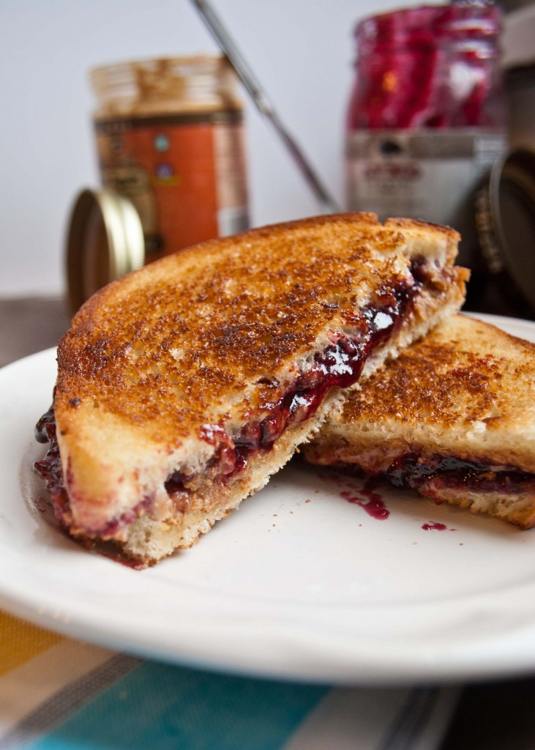
Step 2: Write all materials needed
IF you wanted to make a Peanut Butter and Jelly how would you know to that you needed bread or a knife?

Slide 4
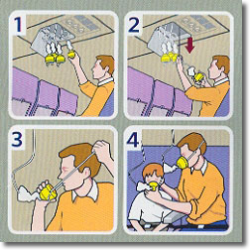
Step 2: Plan how to write the steps in order.
Instructions are written in small increments (manageable tasks that are clear, easy to follow to completion).
You must know what is done first, second, third.

Slide 5
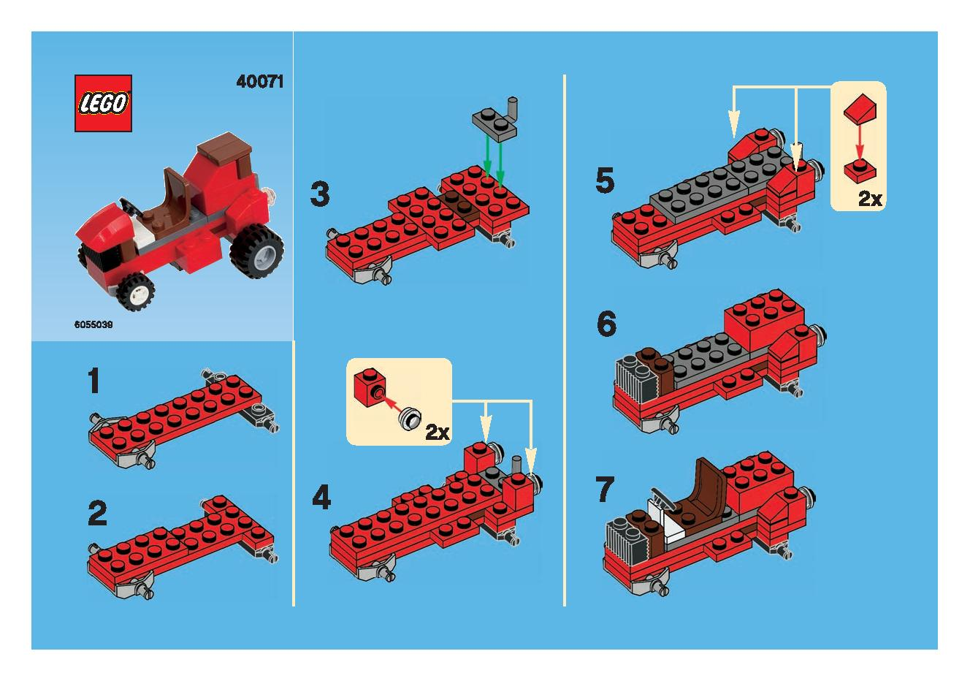
Step 3: Write each step as a small piece.
That means, each step should be small, a baby step in the whole process.
It should be easy to read at once, and then turn and DO it right away.
It shouldn't contain multiple things to do at the same time.

Slide 6
Step 4: Include warnings as pre-steps.
If it's critical that something be done (or NOT be done) before something else, write it as a step to do before the next step.
For example, "check (or close) the drain plug," must be a step before "add oil to the tank."

Slide 7
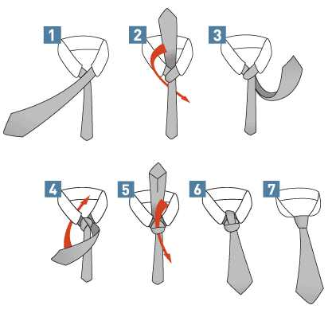
Step 5: Write the steps logically in order.
Don't depend on the reader going down the page and reading all the tips and warnings before beginning to do the process.
Or the reader going to read all the fine points in small print before starting.
Include each point in its own step that begins with a verb.

Slide 8
Step 6: Review and edit your instructions carefully.
Make sure your writing is complete and correct.
We've all seen poorly written instructions for assembling that Christmas toy that make us laugh, but don't get the toy assembled. Don't repeat that mistake.

Slide 9
Step 7: Express steps in the positive.
It's much preferable to say DO something rather than DON'T do something.
For example, instead of saying "don't forget the salt," write "add salt when the eggs boil."

Slide 10
Step 8: Give pictures to help the reader understand the instructions.
Some people are visual learners therefore it is always a good ideal to have pictures that help the individual
IKEA

Slide 11
Write up a good set of instructions:
Write up instructions on how to brush your teeth.
Remember to state all steps even the most basic steps
Follow all instructions to write good instructions

