Slide 1
Warm Up:
Please Log into the Computer
New students to the class please come see Mr. Herman for a index card and a Course Syllabus.
Access mrhermanwestmeck.weebly.com
Access weebly.com in a separate tab…

Slide 2
Weebly.com
Create an account if you don’t already have one. Use an email address you currently have to login.
If you do not have an email address from home. Then use First initial, Last name First 4 of student ID @cms.gaggle.net Password Date of Birth
Bwayne_ _ _ _@cms.gaggle.net Password YYMMDD

Slide 3
Professionalism
Students should take this webpage very seriously. This webpage will be a working portfolio for your Sci-Vis/GAD career. This webpage will also be how you are graded for the class. I will also be sharing your webpage with your parents email address so anything you would not want to share with them do not put on your webpage. Who knows this webpage may even get you into college or a career in Animation or Game Design.

Slide 4
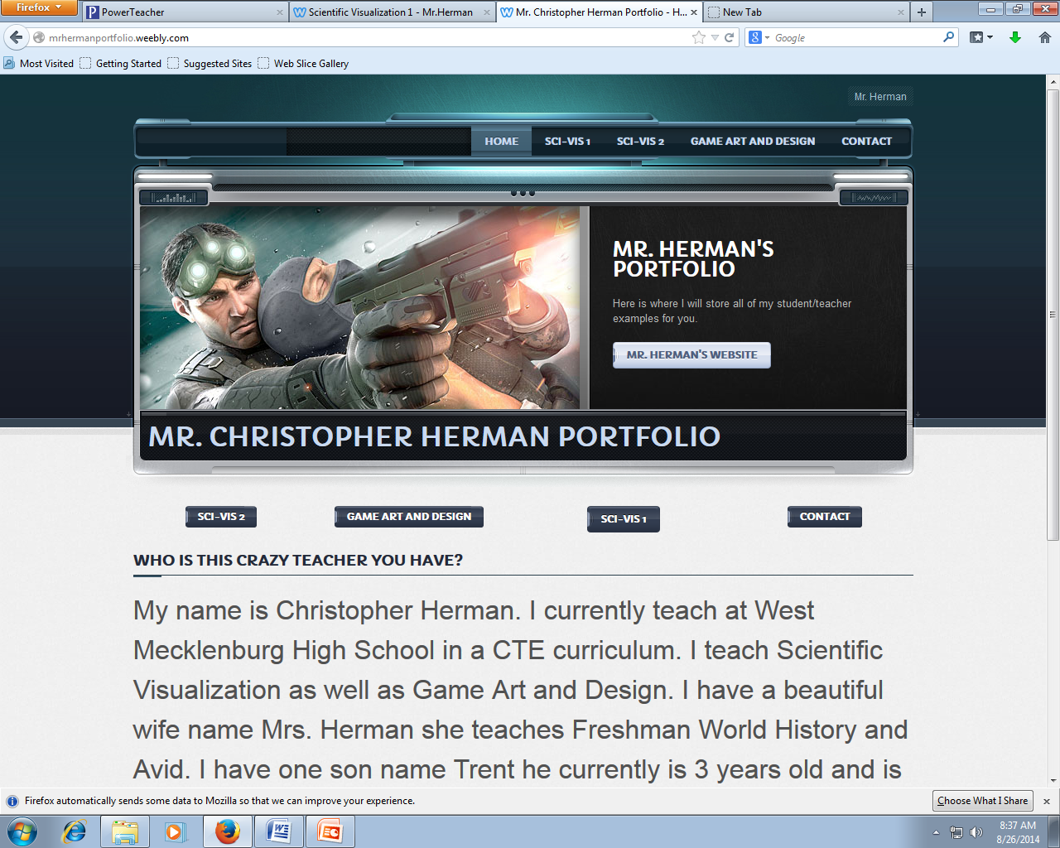
Create a Home Page for Your Website:
Page 1: will be your home screen: This page you will write a one paragraph synopsis of who you are? You will also need buttons to access each page of your website.
Hit to save click Publish

Slide 5
Create Your Student Class Work Page
Page 2: Name this page your name’s course name work
Example: Bruce Wayne’s Game Art and Design Class Work
This page is where you will house all of your work samples and examples on this page
You will also have to create Dividers and project names.
Hit to save click Publish

Slide 6
Create a Contact Page
In this page you will give me your name as well as:
Your email address
Your parents email address
Your webpage name.
Hit to save click Publish

Slide 7
Grading the Web Page
Students will take a Screen shot of their contact page for Mr. Herman.
To complete this task you will have to open your webpage using your URL. Go to your Contact page.
Hold Shift and Print Screen (F13 if there was an F13)
Open up A Word Document and click Paste Enlarge the file to the whole word document.
Print the Document using printer 7579Print509

