Slide 1
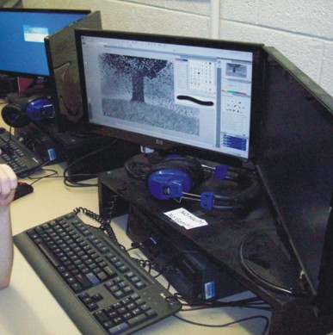
Unit 1
Careers

Slide 2
Career Paths in Game Design

Slide 3
Game Producers/Managers
Job description. The producer is responsible for the overall game development involving coordinating the efforts of all team members meeting deadlines, and budget constraints. Handles any conflicts.
Educational Requirements. no specific educational requirements many employers require a bachelor's degree with years of experience. A degree in business management would be very useful. Some colleges may offer a degree in the producing or business side of game design.

Slide 4
Game Producers/Managers
Skills necessary
communication, leadership, organization, general knowledge of all game development roles, management, and Team work
Typical Day
Coordinating activities of team members - writers, directors, managers, and other staff
Performing management duties such as checking on budget, scheduling, planning, and marketing.
Monitoring the game schedule
Conduct meetings to discuss the game’s progress and to ensure all objectives are attained on time and within the budget.

Slide 5
Game Producers/Managers
Try this quiz http://careerplanning.about.com/library/quiz/career_quizzes/blproducer_quiz.htm

Slide 6
Game Writers
Job description. Game writers research and create the fictional "backstory" for the game, create the on-screen text, write the dialogue for the characters and voiceovers, and script all the scenes including any intros or transitions.
Educational Requirements. A degree in English or creative writing is helpful, as is a background in science fiction or fantasy writing.
Skills necessary
ability to express ideas clearly in writing, good judgment, creative, self motivation and curiosity

Slide 7
Game Writers
Typical Day
creating original works, stories, dialogues
gathering information and -proposing topics
selecting and organizing the written material
Writing to express ideas and convey information
revising or rewriting material
preparing advertising materials
Try this quiz http://careerplanning.about.com/library/quiz/career_quizzes/blwriter_quiz.htm

Slide 8
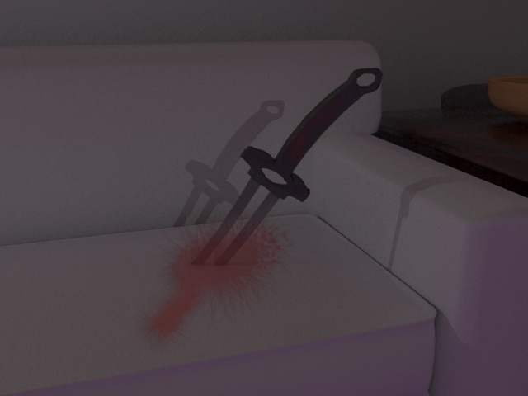
Character Artists and Animators
Job description. Character Artists work with 3D programs such as Maya or 3DS Max to create the characters, items, and background scenery necessary for a game. Animators design the motion involved with characters and design the artistic feel of the game.
Educational Requirements. No degree is necessary, but most people working in this field have degrees in computer science and design. 3D modeling skills are a must.

Slide 9
Character Artists and Animators
Skills necessary
3D modeling, Self motivation, Patience, listening skills, Artistic ability and Time management
Typical Day
Drawing storyboards and creating 3D models and characters
Animating characters and game environments
Working out the timing of character movements to make sure they meet the script and soundtrack requirements.
Working as part of a team

Slide 10
Character Artists and Animators
Try this quiz http://careerplanning.about.com/library/quiz/career_quizzes/blanimator_quiz.htm

Slide 11
Level Designers
Job description. Level Designers create the interactive architecture (both constructed buildings and natural terrain). Also design all the specific gameplay, including scripting enemy goals, skills, and behavior. The term "level" refers to specific areas within the game as well as milestones that the gamer can reach. The levels build upon the skills that the gamer has developed while offering enough difference to give the game variety and complexity.

Slide 12
Level Designers
Educational Requirements. No degree is necessary, but most people working in this field have degrees in computer science and design. 3D modeling and animation skills are a must along with an understanding of the natural world.
Skills necessary
Knowledge of programming languages such as C++
Knowledge of sociology, biology, and physics for realistic looking levels
Animation or computer graphics skills

Slide 13
Level Designers
Typical Day
Creating and sketching different levels
Student image
Using programming to attain the correct look and feel of the level
Working with a team
Debugging and fixing issues in the game

Slide 14
Programmers
Job description. Programmers work on the video game engine, AI, and make the game run using C++ programming language or other languages. They are also responsible for generating the code of the game.
Educational Requirements. Programmers need a bachelor's or master's degree in computer science, mathematics, information systems, or video game production.

Slide 15
Programmers
Skills necessary
Programming skills, Knowledge of object-oriented languages and tools such as C++ and Java, Working as a team, Debugging programming issues
Typical Day
Correcting errors by making appropriate changes and rechecking the programming
Conducting trial runs of the programs and software
Writing code for desired actions
Consulting with the team to clarify intent, identify problems, and suggest changes

Slide 16
Programmers
Try this quiz http://careerplanning.about.com/library/quiz/career_quizzes/blcompprogrammer_quiz.htm

Slide 17
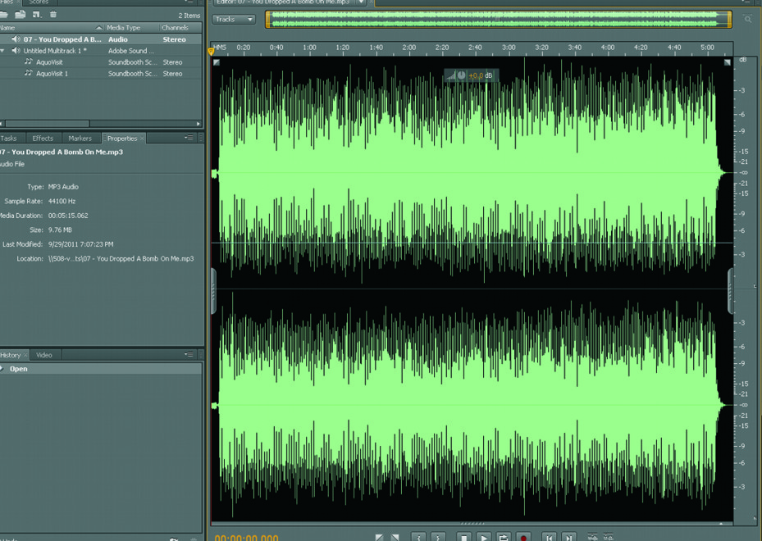
Sound/Audio Designers
Job description. Sound designers produce sound effects and music playing in a game. Sometimes games require original songs or translate instrumental music to a digital format. Machinery and equipment to record, synchronize, mix or reproduce music, voices, or sound effects are used.

Slide 18
Sound/Audio Designers
Educational Requirements. To become an audio engineer one can attend a vocational program that usually lasts about a year. Persons who choose this area of study may take courses in music, computer science and electrical engineering.
Skills necessary
computer music, sound recording, orchestration and harmony , Working as a team, Debugging sound effect issues

Slide 19
Sound/Audio Designers
Typical Day
Working with producers, programmers, and others to determine the desired sound for a game.
Setting up, testing and adjusting recording equipment for recording sessions and sound creations.
Mixing and editing voices, music, and taped sound effects for game levels.
Synchronizing and equalizing prerecorded dialogue, music, and sound effects with visual action of characters motion.
Try this quiz http://careerplanning.about.com/library/quiz/career_quizzes/blaudioeng_quiz.htm

Slide 20
Support Specialist
Job description. A computer support specialist assists users who are having problems with software, computers or peripherals of the game or design of the game. Computer support specialists may also be known as technical support. They can provide help over the phone, or via online chat or email.
Educational Requirements. Some game cells will only hire computer support specialists who have earned a bachelor's degree in computer science or a related area, while other cells prefer those with an associate's degree or relevant experience and certifications.

Slide 21
Support Specialist
Skills necessary
Problem solving skills, Communication skills, Working as a team, Debugging computer hardware and software problems
Typical Day
Overseeing the daily performance of computers and software to verify correct operations and detect errors.
Answering user questions regarding software or hardware.
Setting up equipment including proper installation of cables, operating systems, or appropriate software.
Maintaining records of daily data communication, problems and actions taken, or installation activities.

Slide 22
Support Specialist
Try this quiz
http://careerplanning.about.com/library/quiz/career_quizzes/blcomputersupport_quiz.htm

Slide 23
Professional Tester
Job description. A video game tester puts in long hours to find bugs and other potential problems with a game. Many testers use this opportunity to get into video game design field.
Educational Requirements. Video game testers don't need any specific educational background, but there is a lot of competition for these jobs. Thus you may need to demonstrate expertise with specific games or gaming platforms.

Slide 24
Professional Tester
Skills necessary
Problem solving skills
Good game playing skills
Communication skills
Knowledge of many game platforms
Typical Day
Play the video game offering feedback and reporting any bugs that have gone unnoticed throughout the development process.

Slide 25
Activity 201.11
Video Game Careers: What career is the best for you?
Introduction: Ever wondered what career you might be suited for in the video game field? Take these quizzes and see how you score.
Lesson:
1.Use the Internet to take the quizzes for three of the careers that interest you.
Game Producers/Managers:
http://careerplanning.about.com/library/quiz/career_quizzes/blproducer_quiz.htm
Game Writers
http://careerplanning.about.com/library/quiz/career_quizzes/blwriter_quiz.htm
Character Artists and Animators
http://careerplanning.about.com/library/quiz/career_quizzes/blanimator_quiz.htm
Programmers
http://careerplanning.about.com/library/quiz/career_quizzes/blcompprogrammer_quiz.htm

Slide 26
Activity 201.11
Sound/Audio Designers
http://careerplanning.about.com/library/quiz/career_quizzes/blaudioeng_quiz.htm
Support Specialist
http://careerplanning.about.com/library/quiz/career_quizzes/blcomputersupport_quiz.htm
2. Pick one of the three careers you selected and make a voki describing the career, educational background, and typical day. Also state why you would or would not like to do this career. (see video tutorial) http://www.voki.com/create.php
3. Present your Voki’s to the class.

Slide 27
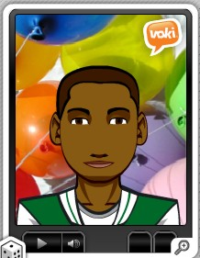
End of Unit 1 Lesson 1

