Slide 1
Warm-Up
Log into the computers
Access mrhermanwestmeck.weebly.com
Open your PowerPoint on kitchens
Find 10 pictures of Kitchens that you like with the URL place them on each slide of your PPT.

Slide 2
What we need for a working Kitchen
Dishwasher
Fridge
Stove/ Oven
Cabinets
Counters
Sink
Windows
Microwave
Island/panisula
Tables/Chairs
Lights
Floors

Slide 3
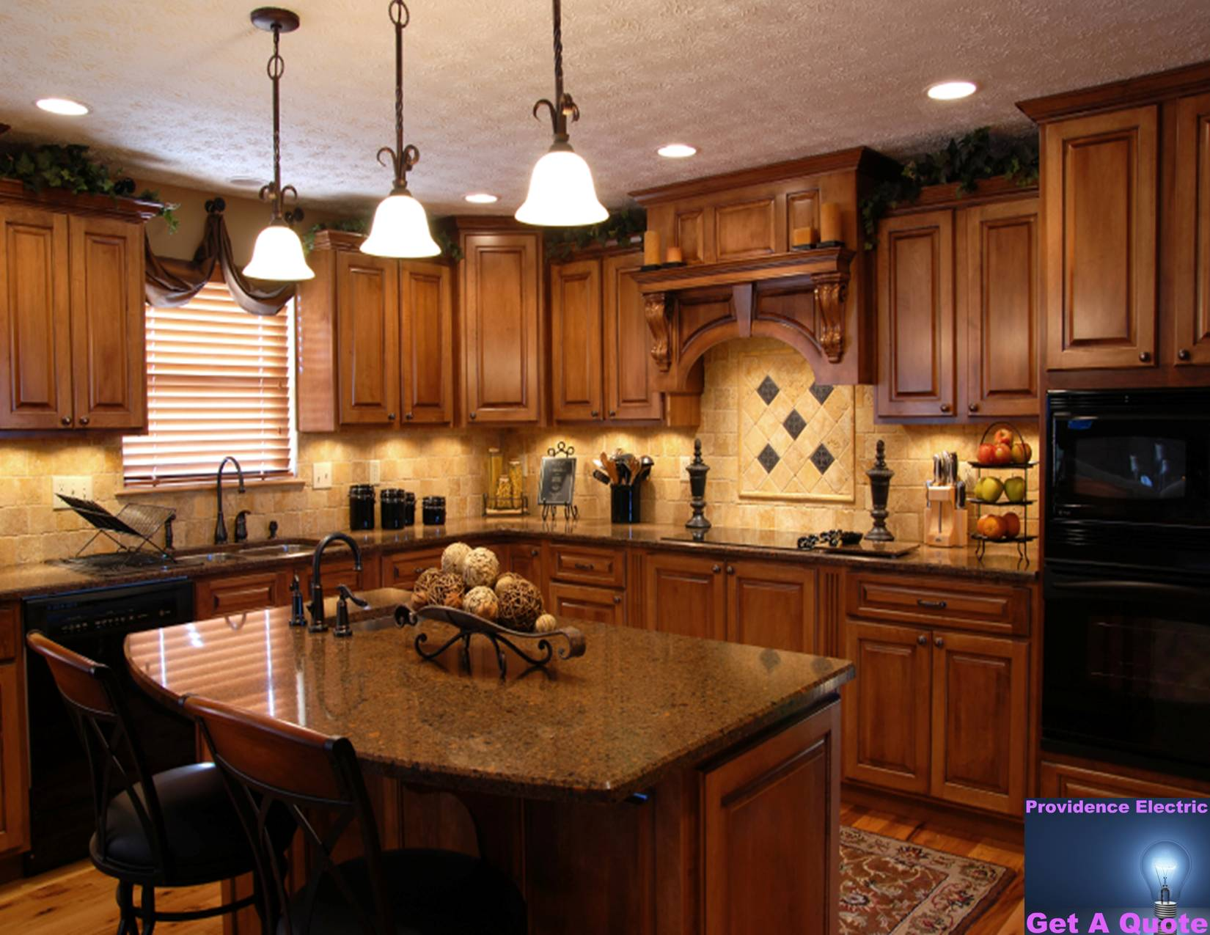
http://www.bing.com/images/search?q=kitchen&FORM=HDRSC2#view=detail&id=04B2CAA435CD0A4EAD214F759626C008F52DC81A&selectedIndex=75

Slide 4
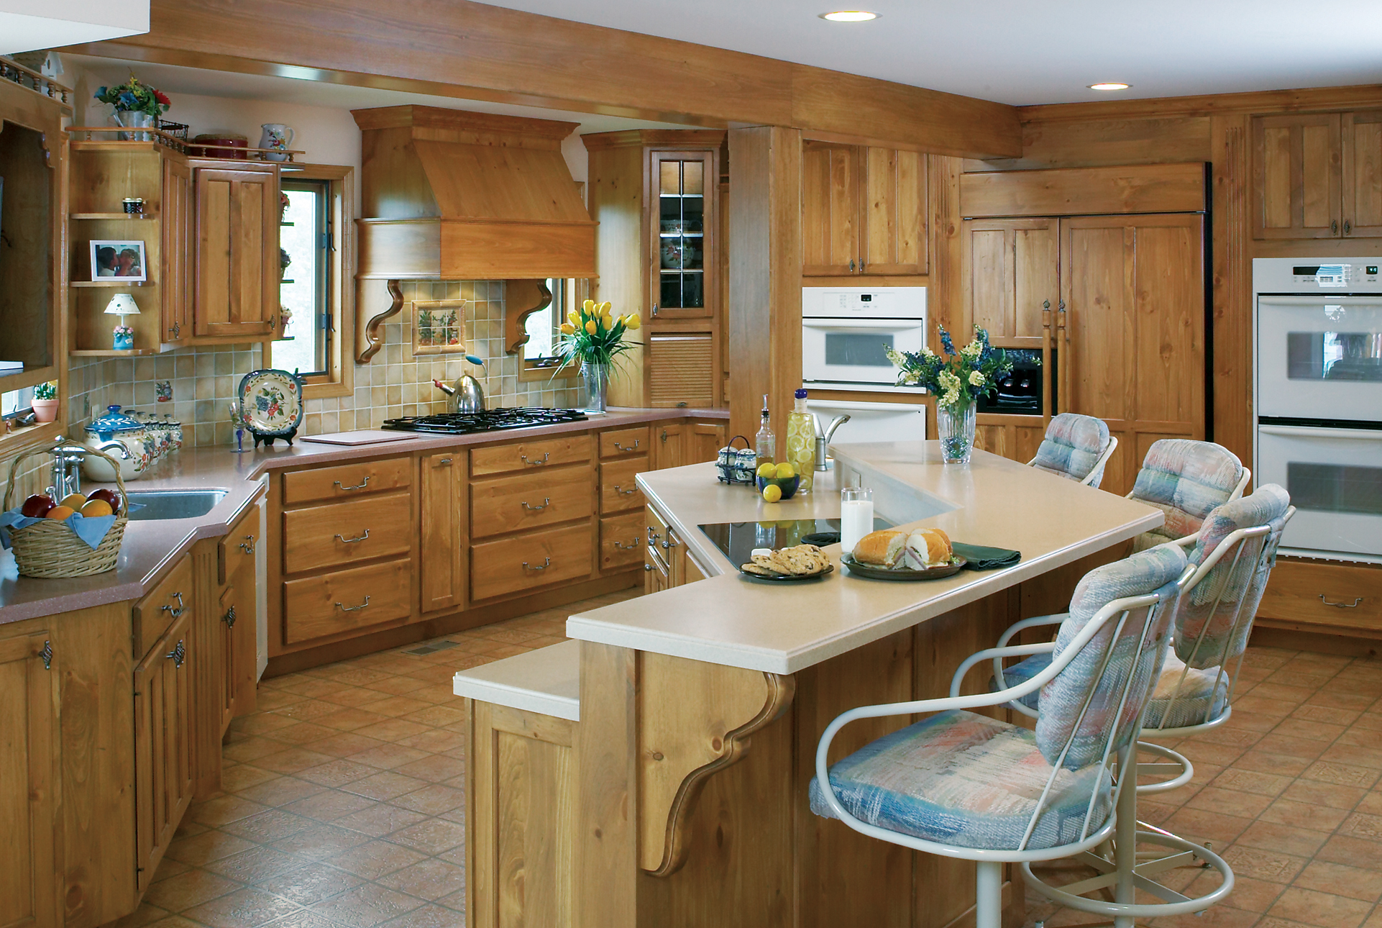
http://www.bing.com/images/search?q=kitchen&FORM=HDRSC2#view=detail&id=CCC9C3307F0DC1CD9618A7904762096C067A95A2&selectedIndex=80

Slide 5
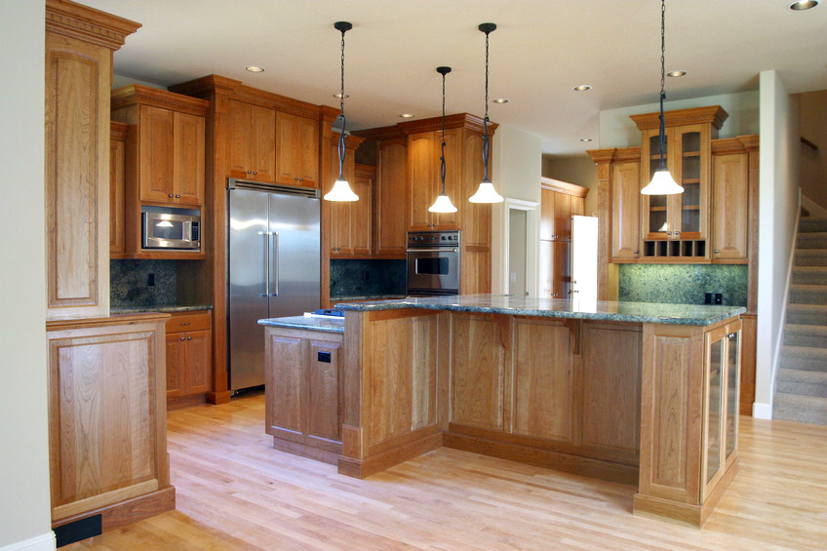
http://www.bing.com/images/search?q=kitchen&FORM=HDRSC2#view=detail&id=EA68EBB9075FD9377042E052FE8B27C18649B0BE&selectedIndex=81

Slide 6
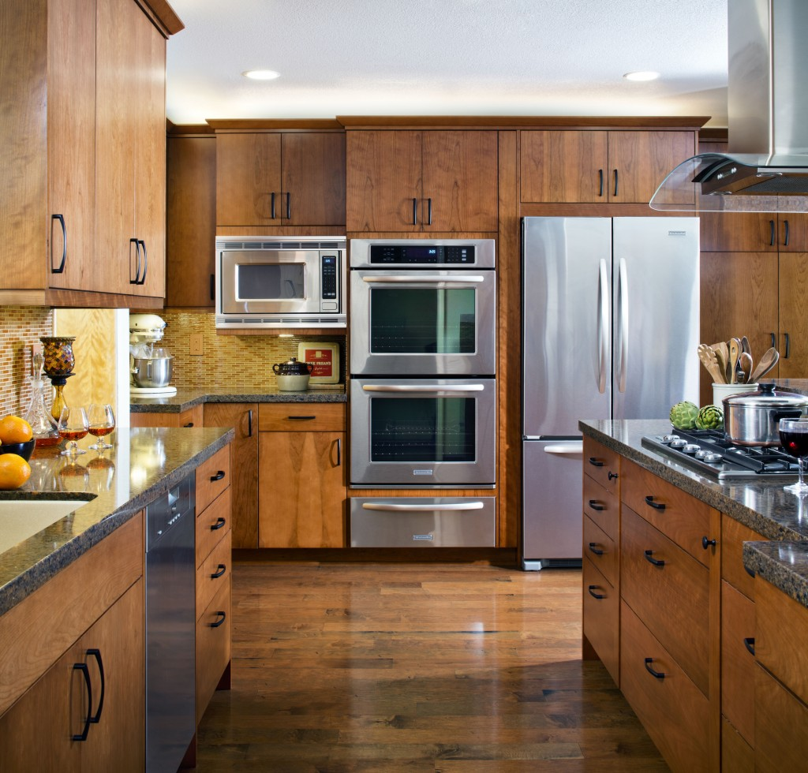
http://www.davisenterprise.com/files/2013/01/kitchen2W-1024x980.jpg

Slide 7
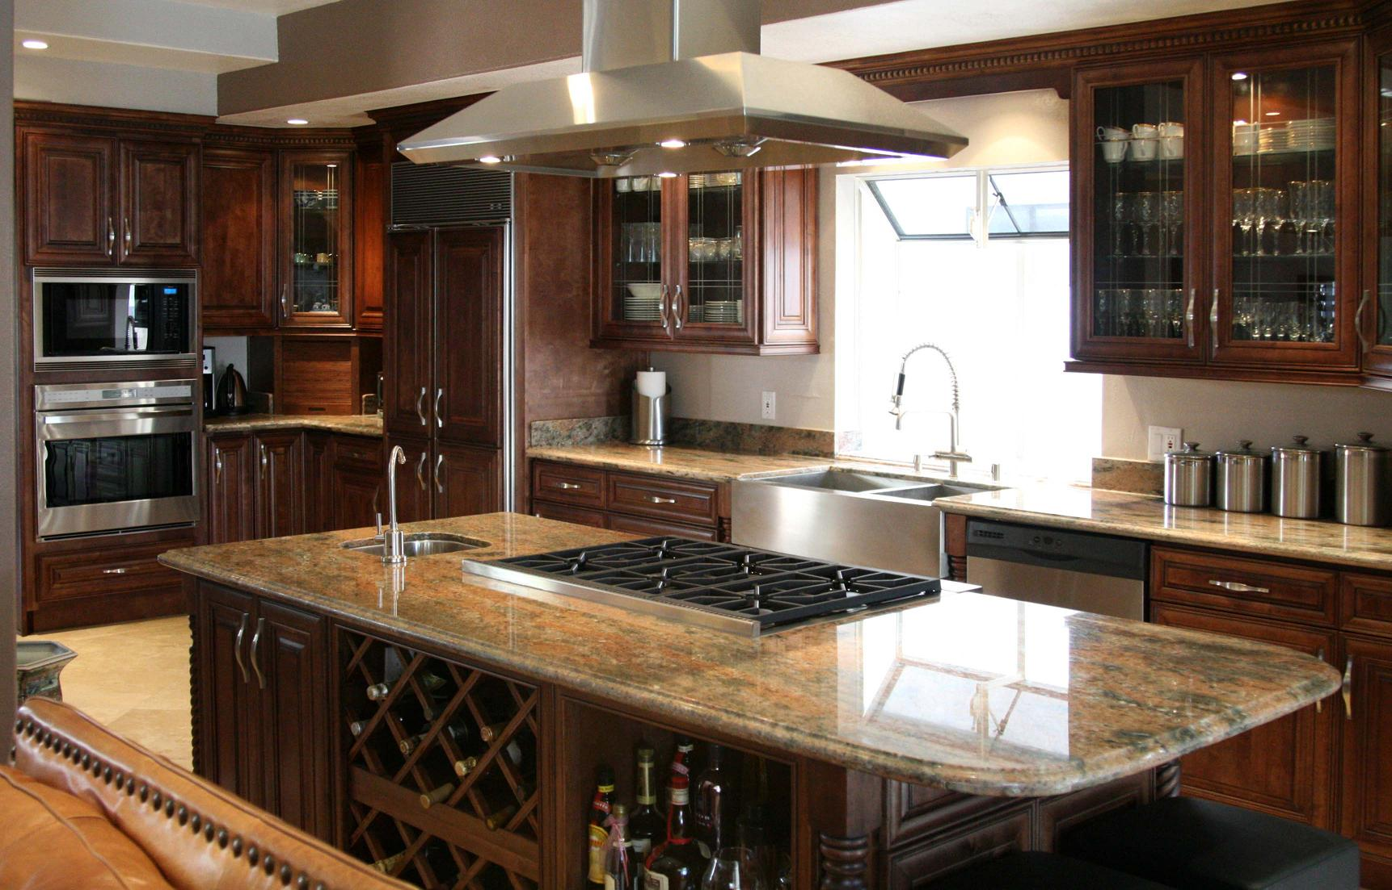
http://www.bing.com/images/search?q=kitchen&FORM=HDRSC2#view=detail&id=51A11F24FA8201F28A36CC103DF41195269852D1&selectedIndex=107

Slide 8
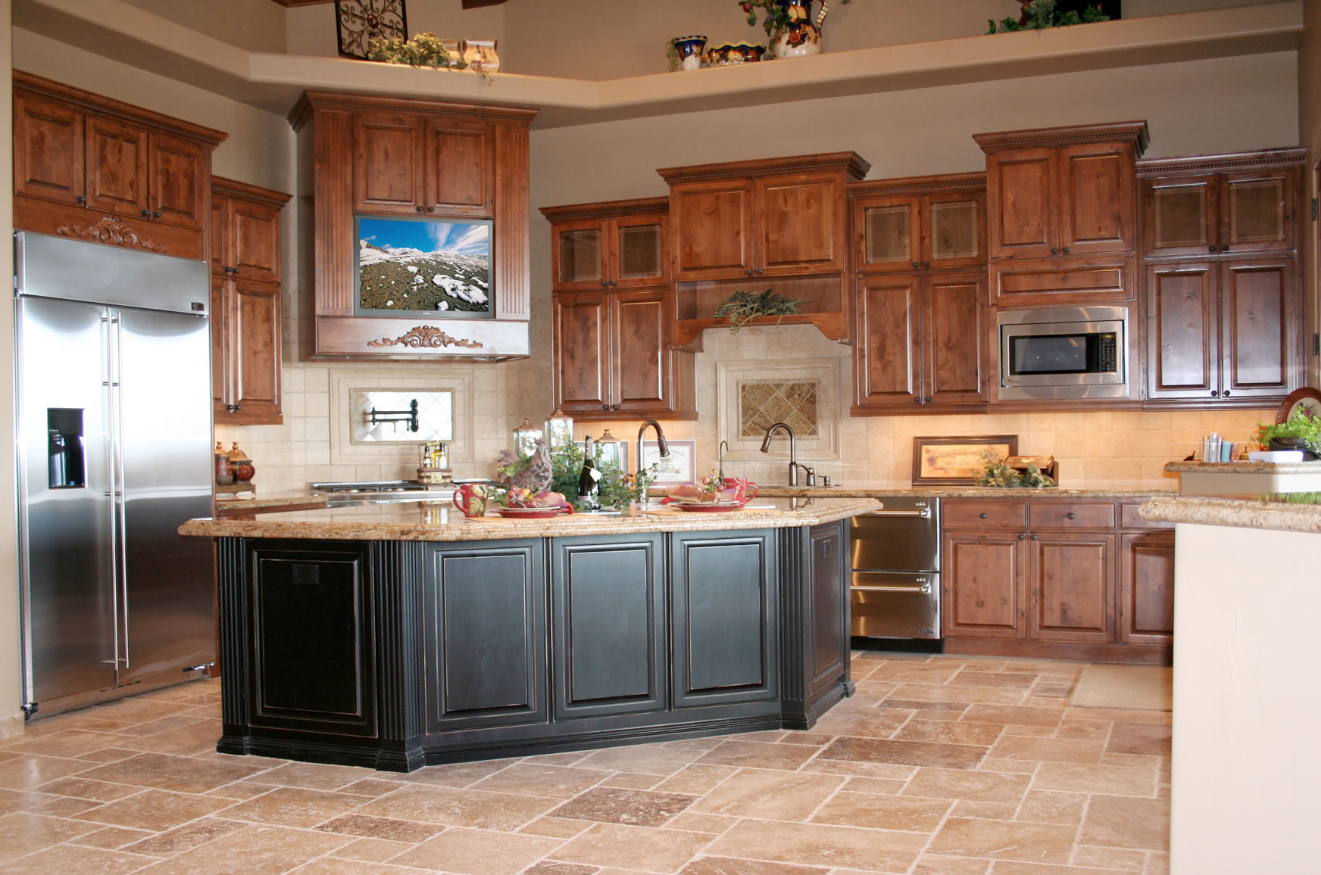
http://www.bing.com/images/search?q=kitchen&FORM=HDRSC2#view=detail&id=EB879739A510498ABB58E4C439621AC831592530&selectedIndex=127

Slide 9
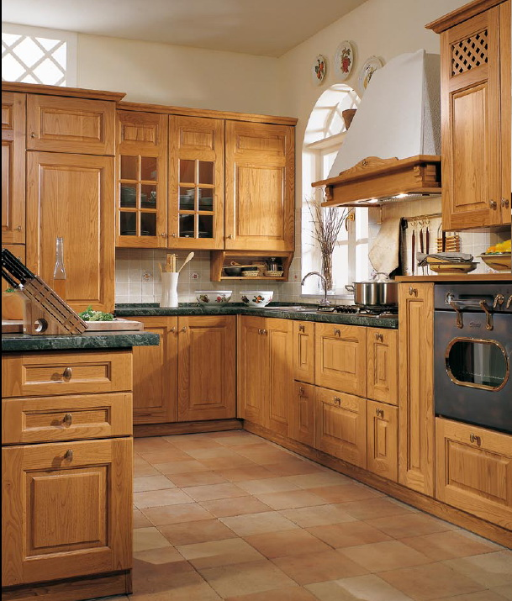
http://www.bing.com/images/search?q=kitchen&FORM=HDRSC2#view=detail&id=AF11251A38549DD025BFEA633486EFA2BE79902A&selectedIndex=145

Slide 10
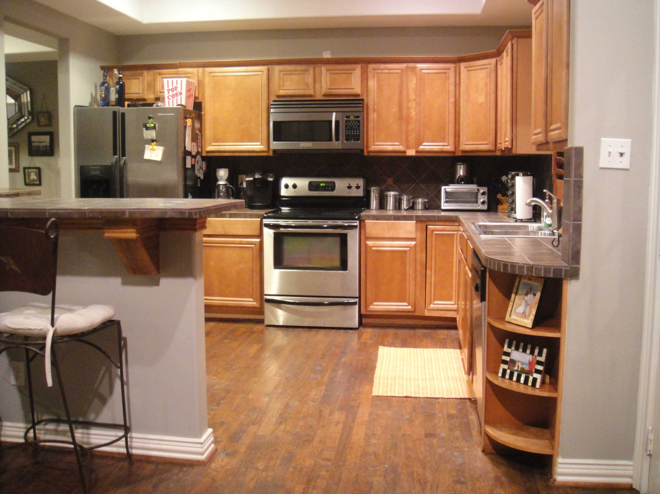
http://www.bing.com/images/search?q=kitchen&FORM=HDRSC2#view=detail&id=3F3256CF575F49409A7677F9A28B3AA5C90EB1FA&selectedIndex=163

Slide 11
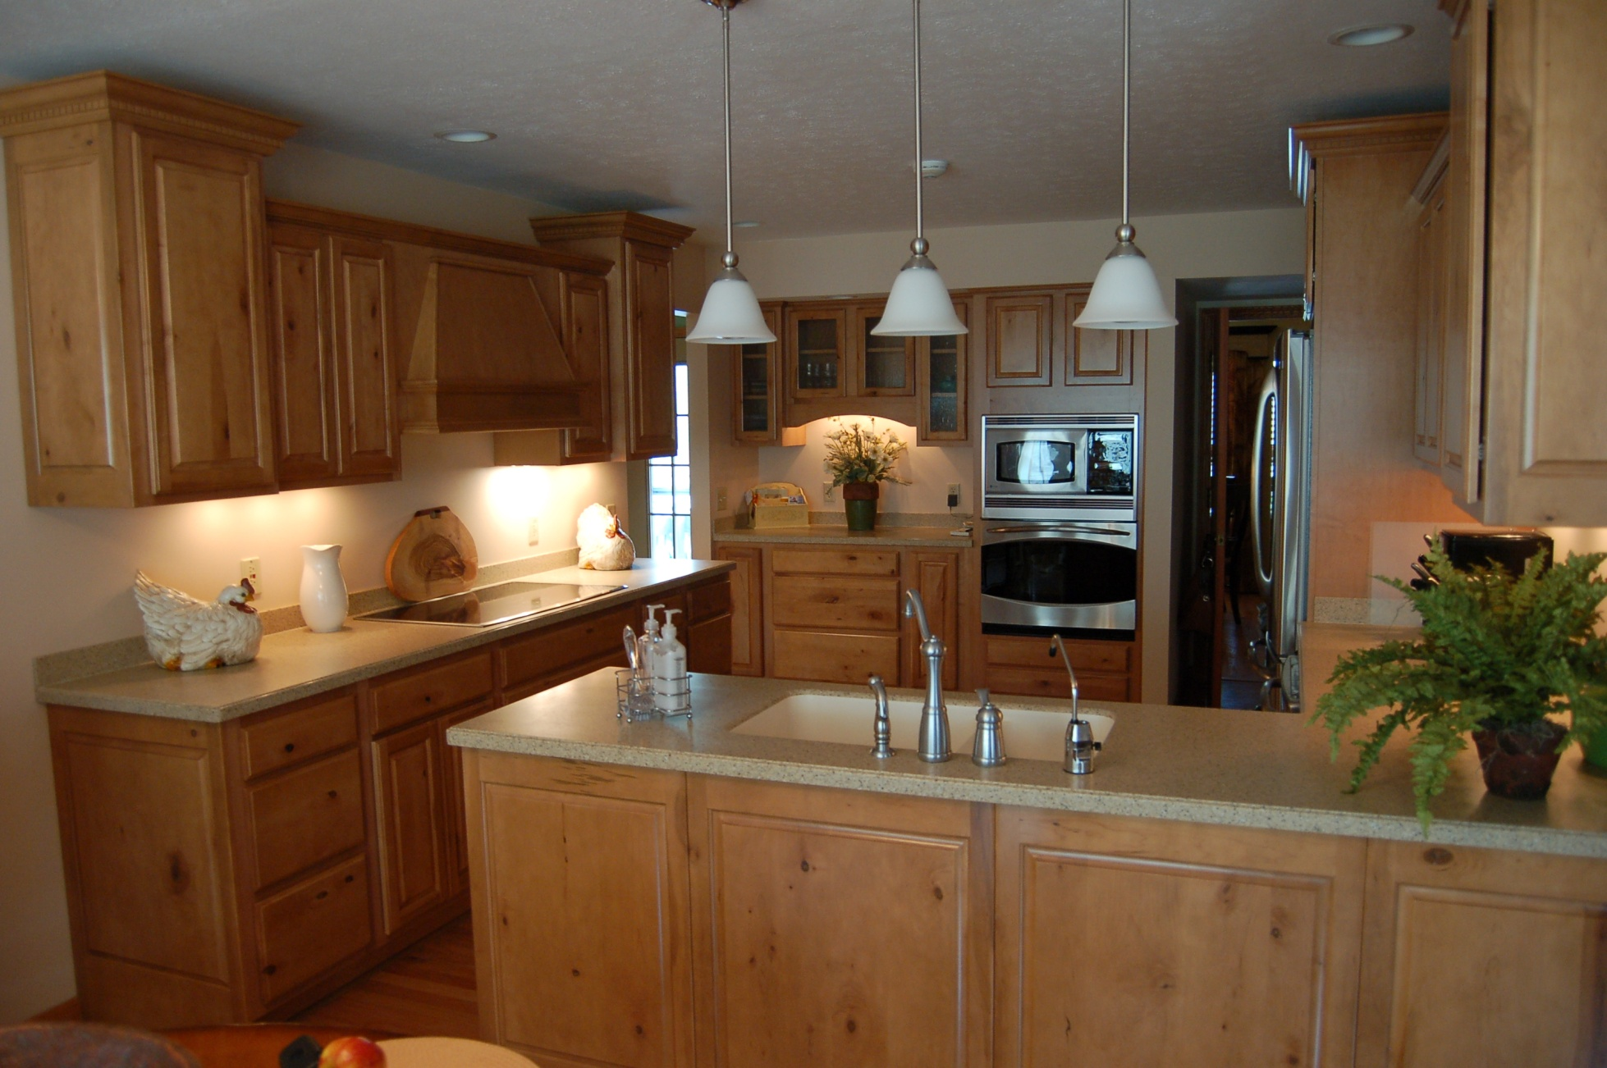
http://www.bing.com/images/search?q=kitchen&FORM=HDRSC2#view=detail&id=A446F9CE78C9FFBFD9D27AB0E4A60A7BA6202873&selectedIndex=174

Slide 12
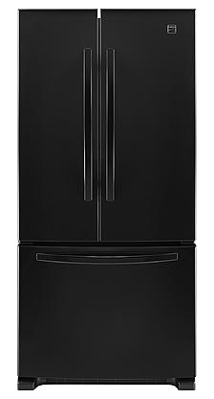
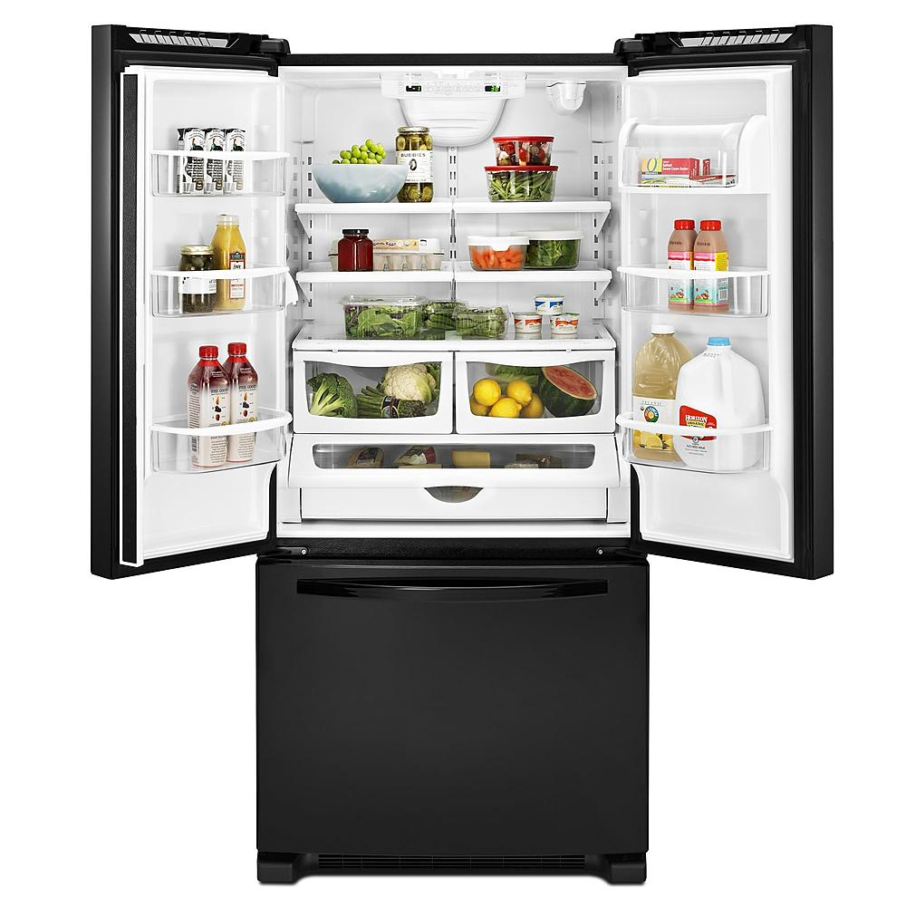
Refrigerator
1200$
http://www.sears.com/Kenmore-219-cu-ft-French-Door-Bottom-Freezer-Refrigerator-wInternal-Dispenser---Stainless-Steel/p-04672009000P

Slide 13
Floor
Different types of Floors: Laminate, Hardwood, Vinyl, Bamboo, Marble, Ceramic Tile

