Slide 1
Independent vs Dependent Variables

Slide 2
Dealing with Data
Independent variable – is the variable that you believe might influence your outcome measure. It is the variable that you control.
It might represent a demographic factor like age or gender. It is graphed on the x-axis.
The different colors of light

Slide 3
Dealing with Data
Dependent variable – is the variable that is influenced or modified by some treatment or exposure (the independent variable).
It may also represent the variable you are trying to predict or the variable that you measure. It is graphed on the y-axis.
Growth of plants.

Slide 4
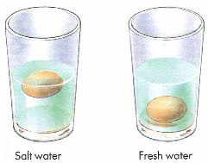
Dealing with Data
Control – In an experimental design refers to keeping outside influences the same for all groups.
The goal in experimental design is to group units in such a way that most unwanted errors would be removed.
A controlled experiment usually results in the most powerful comparisons and the clearest conclusions.

