Slide 1
Energy Sources
Mr. Herman

Slide 2
What is Renewable Energy?
Renewable energy is energy that can be re created or is replenished.
Renewable energy sources are identified as a clean source of energy (minor impact on our environment.)
The sun creates thermal (heat) as well as radiant (light) energy.

Slide 3
What is Solar Energy?
The most direct and simplest way for solar energy to be use is from the direct light and heat from the Sun.
Your home uses windows to draw in direct sunlight into your home.
Digital image. Accessed October 8, 2013. http://us.123rf.com/400wm/400/400/serp/serp0901/serp090100037/4156573-open-window-against-a-blue-wall-and-the-cloudy-sky-and-sun.jpg.

Slide 4
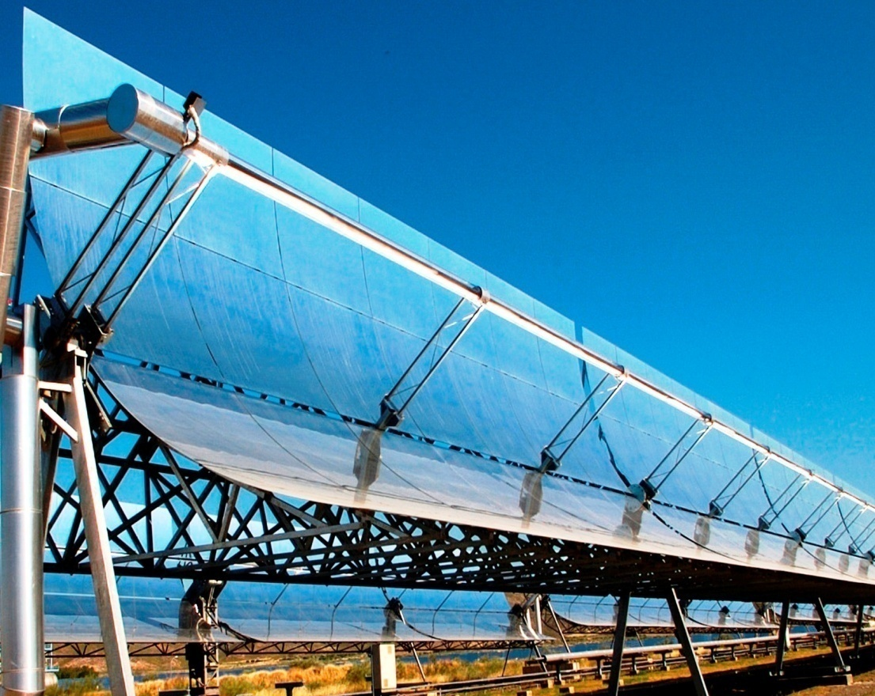
How to use Solar Energy to Create Electricity?
Concentrating Solar Power
large curved shaped mirror that focuses the thermal and radiant heat to one pipe.
The steam created by the thermal energy then turns a turbine
Resulting in the production of electricity.
"CSP Could Help Achieve India's Energy Future: Report." Digital image. EnergyNext RSS. Accessed October 08, 2013. http://www.energynext.in/csp-help-achieve-indias-energy-future-report/.

Slide 5
How to use Solar Energy to Create Electricity?
Photovoltaic (PV) cells (aka solar cells) convert sun light into electricity.
Sunlight is absorbed in the solar cells.
The absorb sunlight's creates voids in the Solar cells making electrons move rapidly
"Sculptural Solar Trees Spring Up At Charlotte's Discovery Place Museum ..." Accessed October 8, 2013. http://assets.inhabitat.com/wp-content/blogs.dir/1/files/2012/05/Discovery_Place_Spotlight_Solar_Inhabitat1-537x439.jpg.

Slide 6
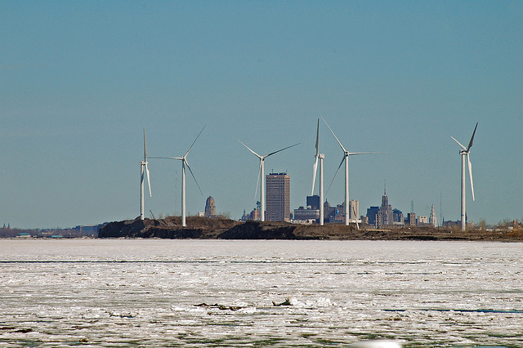
How can Wind Energy be converted in Electricity?
Different temperatures on the earth surfaces creates wind
Wind energy then turns a Turbine
The turbine then turns a generator
The generator creates Electricity
Wind Farm in Lackawana, NY. Digital image. Accessed October 8, 2013. http://farm1.staticflickr.com/184/438081492_c787d638ec_z.jpg.

Slide 7
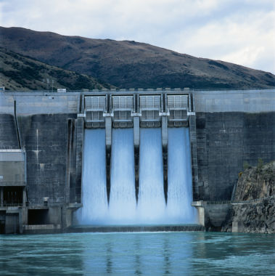
What is Hydropower?
Sun’s energy (solar) heats up water and causes water to evaporate.
The evaporated water condenses to forms clouds.
Clouds become to full and creates participation.
The Kinetic energy from moving water can create electricity
"Hydropower." Digital image. Accessed October 8, 2013. http://www.taosfriction.com/wp-content/uploads/2011/10/hydropower.jpg.

Slide 8
What is Biomass?
Plants absorb light energy from the sun called photosynthesis
Biomass is an organic material that is created by plants and animal waste.
different types of biomass such as wood, crops, manure, and garbage.
Kusekwa, Mashauri Adam. "Chapter 11." Biomass Conversion to Energy in Tanzania: A Critique. March 13, 2013. Accessed October 08, 2013. http://www.intechopen.com/books/new-developments-in-renewable-energy/biomass-conversion-to-energy-in-tanzania-a-critique.

Slide 9
Non-Renewable Energy
Non-renewable energy does not get replenished for a very long time.
Most non-renewable energy sources appear from the ground in liquid, gas or solids.
are also harmful to the environment, however non-renewable energy makes up 85% of our energy.

Slide 10
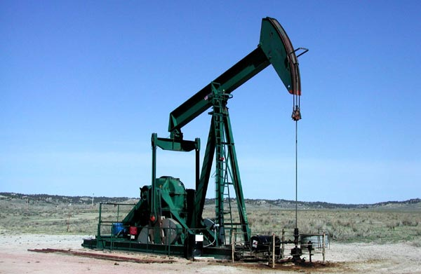
What is Crude Oil?
Crude oil is formed from the breakdown of fossils.
Pressure and heat from sand and silt will start breaking down the fossils.
Common Fossil Fuels are Gasoline and Diesel
"Http://finweek.info/wp-content/uploads/2011/03/Crude_Oil.jpg." Digital image. Accessed October 8, 2013. http://finweek.info/wp-content/uploads/2011/03/Crude_Oil.jpg.

Slide 11
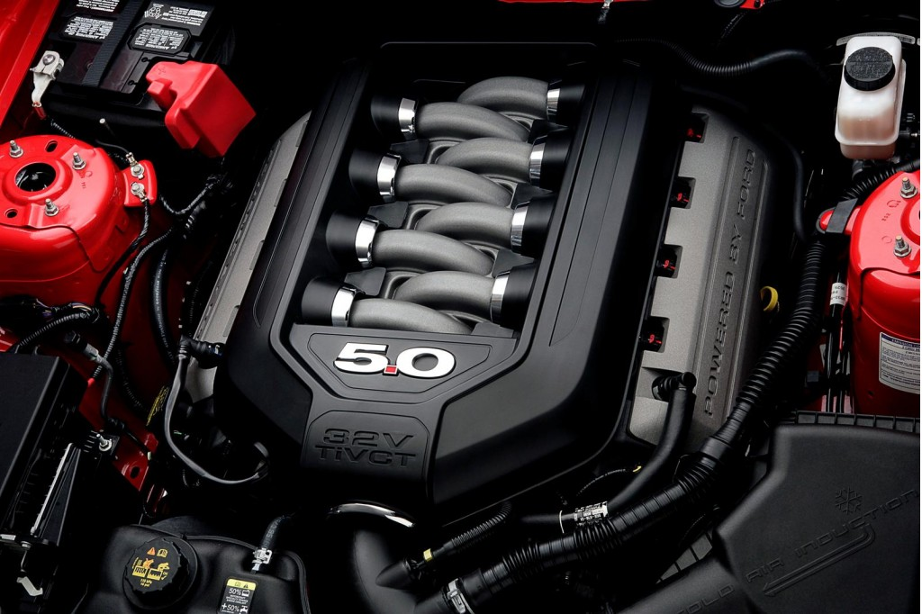
How does a Gasoline/Diesel Engine work?
Gasoline and Diesel engine creates a small explosion contained in the engine.
Three essentials are needed for an explosion
spark (spark plug)
fuel (gasoline)
oxygen. (intake)
"2011 Ford Mustang GT 5.0 Engine." Digital image. The Car Connection. Accessed October 8, 2013. http://images.thecarconnection.com/lrg/2011-ford-mustang-gt-5-0-engine_100303262_l.jpg.
How engines work
Http://www.youtube.com/watch?v=OGj8OneMjek. Accessed October 8, 2013. http://www.youtube.com/watch?v=OGj8OneMjek.

Slide 12
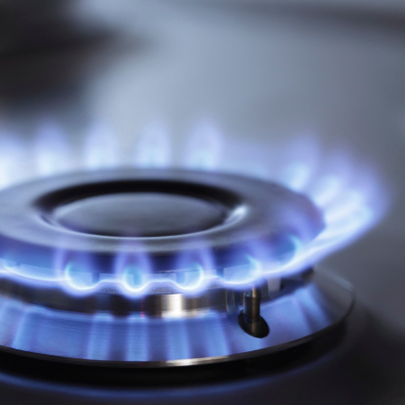
What is Natural Gas?
Natural Gas is an odorless gas used for heating and appliances
Natural gas is the product of breaking down fossils
Natural Gas is found in Shale
"Natural Gas ETFs to Play the Rally." Digital image. Accessed October 8, 2013. http://www.etftrends.com/wp-content/uploads/2013/03/natural-gas-ETFs1.jpg.

Slide 13
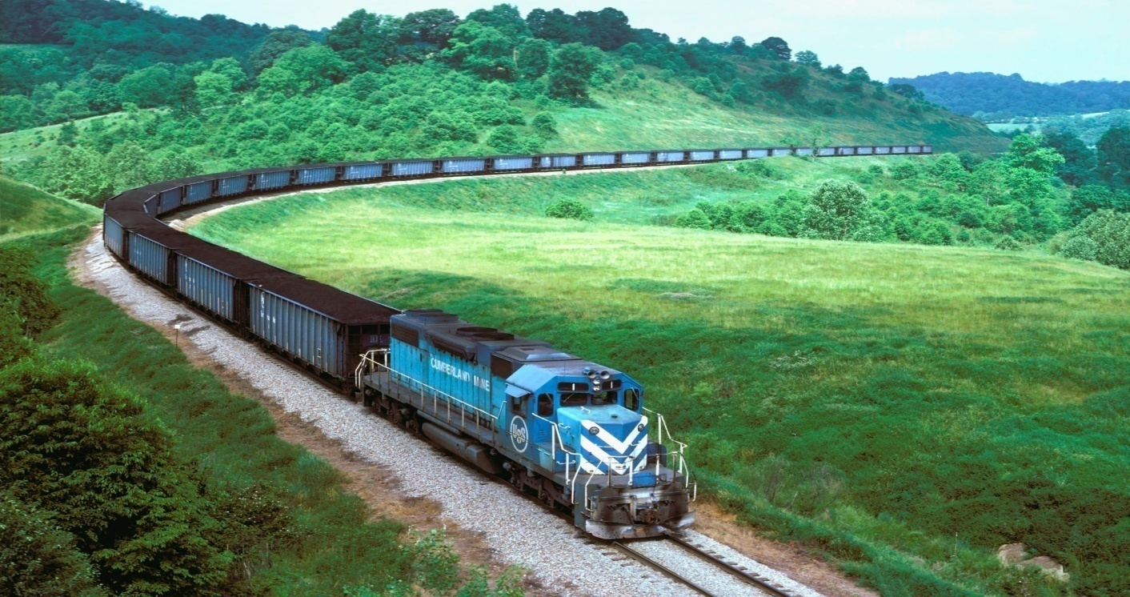
What is Coal?
Coal is a brownish black sedimentary rock.
Coal is consisted of carbon and hydrocarbon material.
Like other fossil fuels coal is also created by plants that lived millions of years ago.
The pressure of the dirt, sand and water create the coal.
Digital image. Train Transporting Coal Wallpaper. Accessed October 8, 2013. http://trainwallpapers.com/bulkupload/wallpapers/Transport%20Trains/train-transporting-coal.jpg.

Slide 14
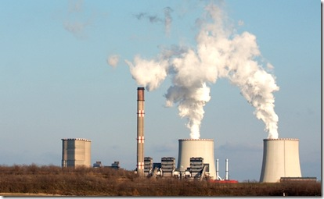
What is Nuclear Energy?
Uranium is a non-renewable
Uranium is used in the creation of nuclear energy.
Uranium is split in the nucleus
The nucleus is held together by an abundant amount of energy
Clover, SC Nuclear PowerPlant. Digital image. Columbiabussinessreport.com. Accessed October 8, 2013. http://scbiznews.s3.amazonaws.com/shutterstock_386556974.jpg.

Slide 15
https://www.google.com/search?q=energy+source+game&ie=utf-8&oe=utf-8&aq=t&rls=org.mozilla:en-US:official&client=firefox-a

Slide 16
Bibliography
"Solar." EIA Energy Kids -. Accessed September 27, 2013. http://www.eia.gov/kids/energy.cfm?page=solar_home-basics.
"Wind." EIA Energy Kids -. Accessed September 27, 2013. http://www.eia.gov/kids/energy.cfm?page=wind_home-basics.
"Hydropower." EIA Energy Kids -. Accessed September 27, 2013. http://www.eia.gov/kids/energy.cfm?page=hydropower_home-basics.
"Biomass." EIA Energy Kids -. Accessed September 27, 2013. http://www.eia.gov/kids/energy.cfm?page=biomass_home-basics.
"Oil (petroleum)." EIA Energy Kids -. Accessed September 27, 2013. http://www.eia.gov/kids/energy.cfm?page=oil_home-basics.
"Gasoline." EIA Energy Kids -. Accessed September 27, 2013. http://www.eia.gov/kids/energy.cfm?page=gasoline_home-basics.
"Diesel Fuel." EIA Energy Kids -. Accessed September 27, 2013. http://www.eia.gov/kids/energy.cfm?page=diesel_home-basics.

Slide 17
Bibliography continued
"Natural Gas." EIA Energy Kids -. Accessed September 27, 2013. http://www.eia.gov/kids/energy.cfm?page=natural_gas_home-basics.
"Coal." EIA Energy Kids -. Accessed September 27, 2013. http://www.eia.gov/kids/energy.cfm?page=coal_home-basics.
"Uranium (nuclear)." EIA Energy Kids -. Accessed September 27, 2013. http://www.eia.gov/kids/energy.cfm?page=nuclear_home-basics.

