Slide 1
What is a Hyperlinks
An element in an electronic document that links to another place in the same document or to an entirely different document. Typically, you click on the hyperlink to follow the link. Hyperlinks are the most essential ingredient of all hypertext systems, including the World Wide Web.

Slide 2
Open up Microsoft PowerPoint

Slide 3
Go to the Insert Tab

Slide 4
Click on Hyperlink

Slide 5
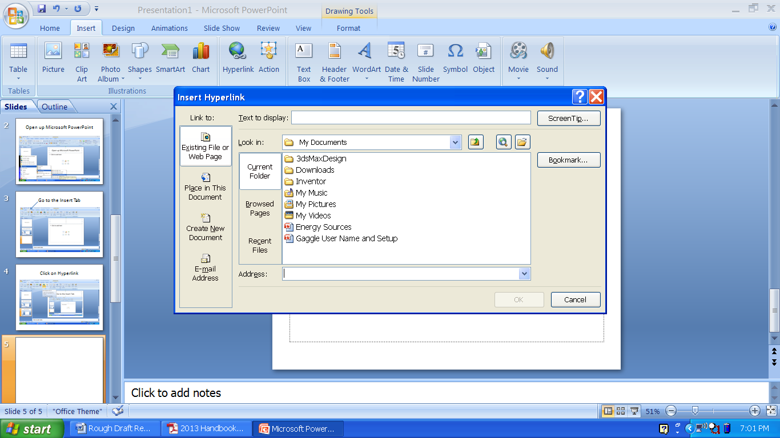
Existing File or Webpage is great for placing a Hyperlink to a different file such as Adobe Illustrator or a YouTube video

Slide 6
Place in this document is a hyperlink for different pages in the PowerPoint.

