Slide 1
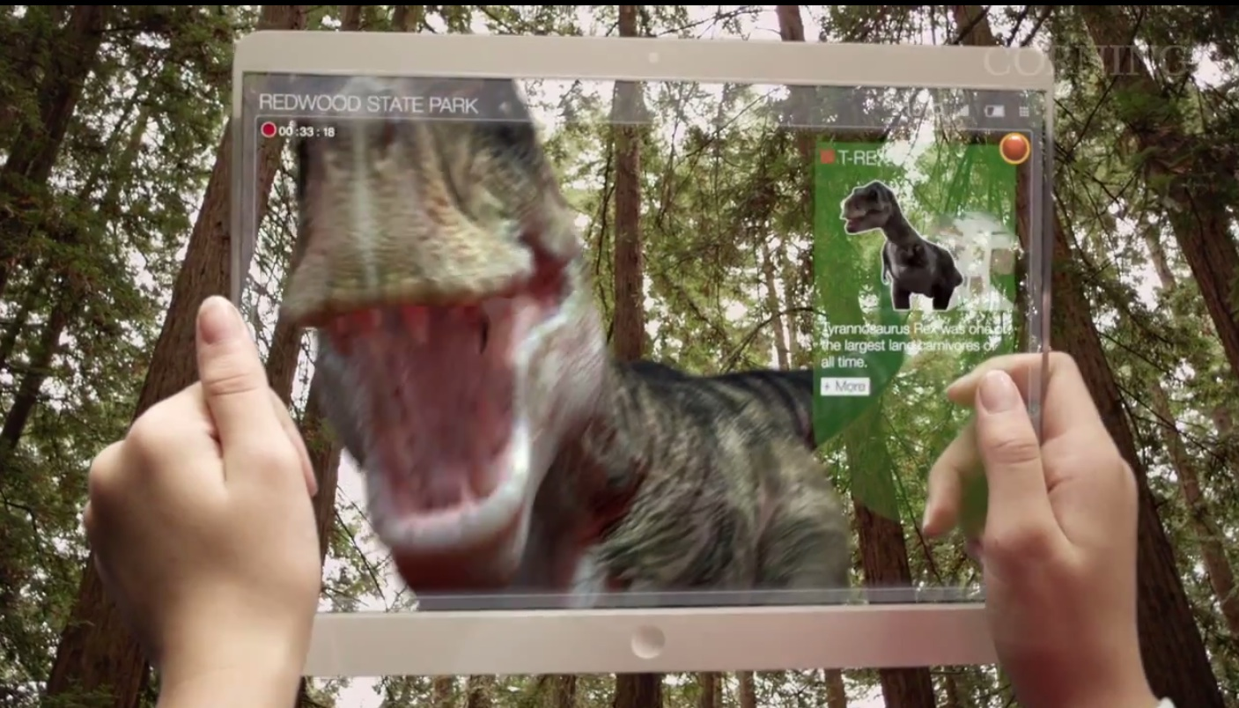
Corning’s “A Day Made of Glass” Essay
Write a 1.5-2 page paper on the video
Paragraph 1 describe the phenomena that took place in the videos.
Paragraph 2: Select one or two technologies that you would like to have in your daily life and how you would use it (socially, school, entertainment.)
Paragraph 3: With the one technology you have how would it effect society such as jobs, technology dependent, different products it would replace etc.
Paragraph 4: Conclusion sum up all parts of your essay

