Slide 1
Basic Commands in 3ds Max
By Mr. Herman

Slide 2
What is in this PowerPoint?
In this PowerPoint you will learn how to complete the basic commands in 3ds Max. If you know the tasks listed below you can create almost any object In 3ds max with a little critical thinking!
The Basic commands in 3ds Max:
Standard Primitives
Boolean
Editable Poly
Add a material (Bitmapping)

Slide 3
How do you set up your 3ds Max drawings?
Step 1: Maximize Viewpoint Toggle.

Slide 4
How do you set up your 3ds Max drawings?
Step 2: Change Preferences:

Slide 5
How do you set up your 3ds Max drawings?
Step 3: Scene undo Levels to 100

Slide 6
How do you set up your 3ds Max drawings?
Step 4: Turn off Auto backup
Step 5: Press OK at the bottom Right of the Screen

Slide 7
Standard Primitives Tips:
The Sun Creates all objects
The rainbow Modifies objects
There are more objects from the drop down menu
Name and Color can be use to name the object and change the color (Duh)

Slide 8
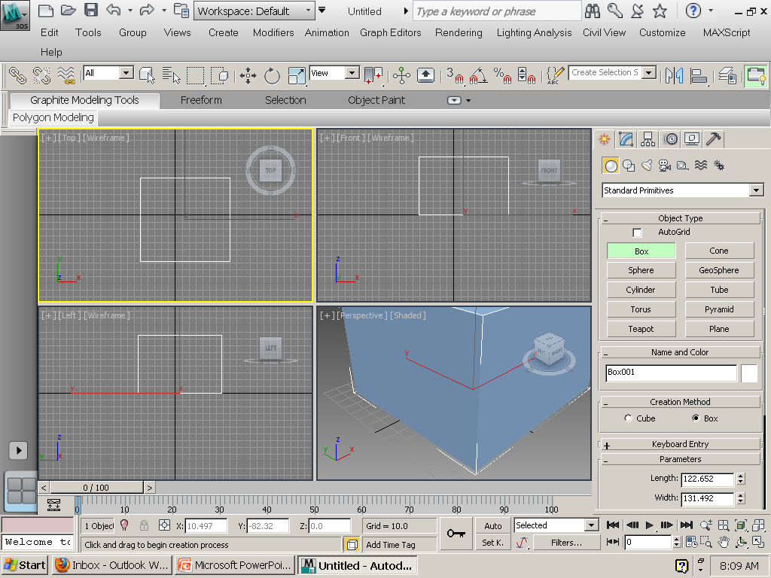
What are some Standard Primitive Tips Continued:
Always draw in the Top View
Center the View Using the lower Coordinates set the first shape to 0,0,0
*Tip Select and Move as well as the object must be selected!

Slide 9
How do you Modify your Standard Primitive?
Click on the blue rainbow (Bent tube)
Change the Parameters to the desired length, width and Height
Segments (segs) can be use to manipulate your object using Editable Poly later

Slide 10
How do you modify the Standard Primitives Using Editable Poly
On the modify menu (blue rainbow) Click on the Drop down menu(modify List) to select editable poly.

Slide 11
What can you do with the Editable Poly using Vertices and Polygon?
The Vertices manipulate the dots that connect to create that shape.
The Polygon manipulates the shape by using the faces of the shape

Slide 12
What can you do with the Editable Poly using Vertices and Polygon?
The Edit Poly Menu has some cool things you can do to change your Standard Primitive such as: Extrude- Expanding the shape From a face, Soft-Selection transform part of a shape, and Quick slice which adds more vertices

Slide 13
How do you combine two shapes using Boolean?
Step 1: Click on the Sun Create button
Change the box to Compound Objects
Click on Boolean
*Tip* One shape must be selected!

Slide 14
How do you combine two shapes using Boolean?
Click on Pick Operand B and select the other object you want to subtract or connect to the other
If the shape does not appear to what you want change the Subtraction from (A-B) or (B-A)
*Tip* To boolean Multiple objects use Pro-Boolean

Slide 15
How do you Add a Bitmap to the image?
First step you will want to add A UVW mapping as an edit modifier
Click off the Real World map Size
*Tip*This will allow you to continue to modify the box if you have to later. It also eliminate UVW tiling as well.

Slide 16
How do you Add a Bitmap to the image?
Click the letter “M” for material on the Keyboard
Make sure your Material Editor is on Compact Material Editor
Select the box labeled color gray

Slide 17
How do you Add a Bitmap to the image?
Find the image that you have saved from the internet.
It is best to save it under the Autodesk File in the documents.

Slide 18
How do you Add a Bitmap to the image?
Once you Find the image click on Open

Slide 19
How do you Add a Bitmap to the image?
Click on the Show Standard map in Viewpoint so you can see your bitmap on your 3d model

Slide 20
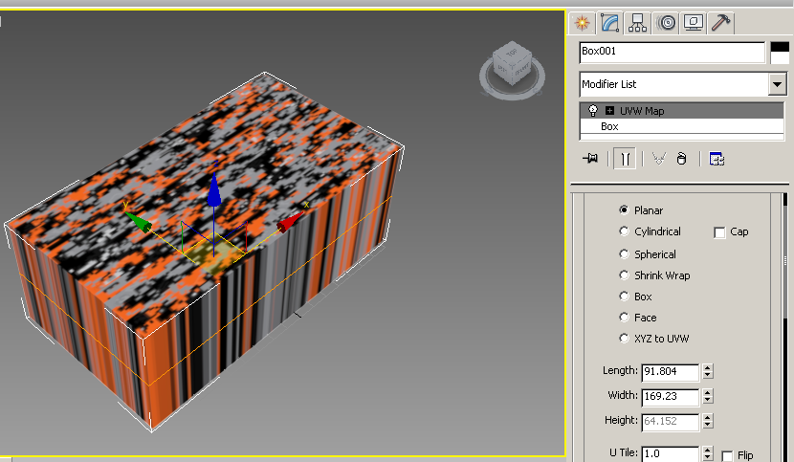
How do you Add a Bitmap to the image?
If you are adding a bitmap to all sides your shape may turn out like this one.
If you click on Face from the UVW map Modifier list the bitmap will be placed on all faces of the object and will appear correct.

Slide 21
What is in this PowerPoint?
In this PowerPoint you will learn how to complete the basic commands in 3ds Max. If you know the tasks listed below you can create almost any object In 3ds max with a little critical thinking!
The Basic commands in 3ds Max:
Standard Primitives
Boolean
Editable Poly
Add a material (Bitmapping)

